Slide 1
MySQL Tests (Outside vs. Inside Network)
12 April 2018

Slide 2
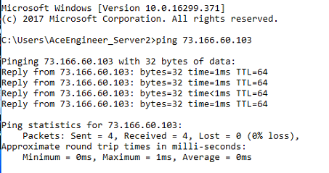
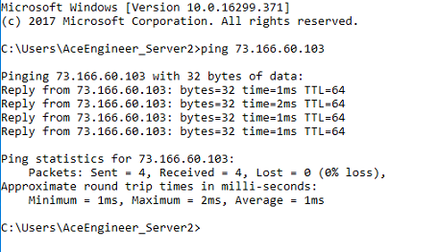
Test 1
Left Side Test conducted on My computer
Right Side Test conducted on Server 2
Successful ping from India computer

Slide 3


Test 2
Below Test on My computer
Below Test on Server 2, Server 1 and MP’s Computer.
Edited firewall settings to help this result.
Telnet port test successful from India computer
Telnet port test successful from Local Computers (Server 1 and 2)

Slide 4

Test 3 | Local Computers
python mySQLConnector.py --MySQLServerName="73.166.60.103" --MySQLDatabaseName="krishna-d" --MySQLUserName="AceEngineer" --MySQLPassword="Ace@DataWare!2020"
Successful connections from Servers 1 and 2

Slide 5
Test 3 | GSY/India Computer
python mySQLConnector.py --MySQLServerName="73.166.60.103" --MySQLDatabaseName="krishna-d" --MySQLUserName="AceEngineer" --MySQLPassword="Ace@DataWare!2020"
Successful connections from India Computer

Slide 6
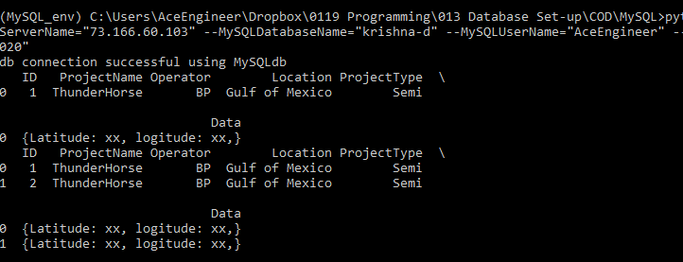
Test 4 | Local Computer
python mySQLWriteData.py --MySQLServerName=“localhost" --MySQLDatabaseName="krishna-d" --MySQLUserName="AceEngineer" --MySQLPassword="Ace@DataWare!2020"
Successful connections from Servers 1 and 2

Slide 7
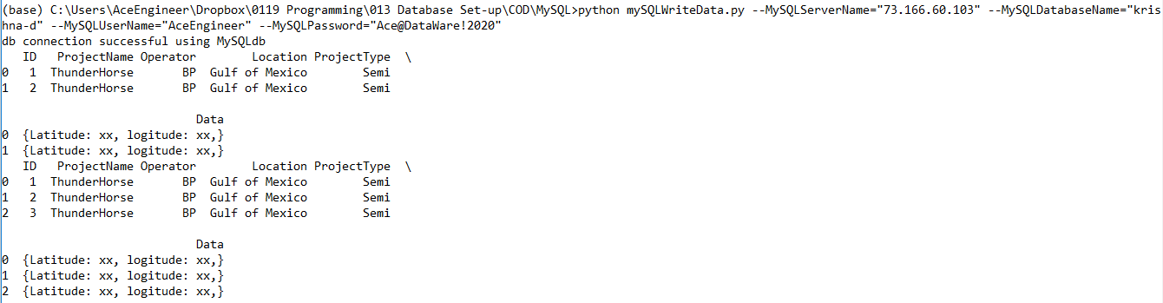
Test 4 | GSY/India Computer
python mySQLWriteData.py --MySQLServerName="73.166.60.103" --MySQLDatabaseName="krishna-d" --MySQLUserName="AceEngineer" --MySQLPassword="Ace@DataWare!2020"
Successful connections from India Computer

Slide 8
Way Forward
Development Testing is successfully completed
Server 2 Security enhancements performed:
Router/computer entry only to the port 3306
Updated windows firewall for server 2 entry only to the relevant port
Firewall blocked
Tested on local computers
Ganga to test his computer to ensure everything still works

Slide 9
THANK YOU
For the opportunity to serve

Slide 10
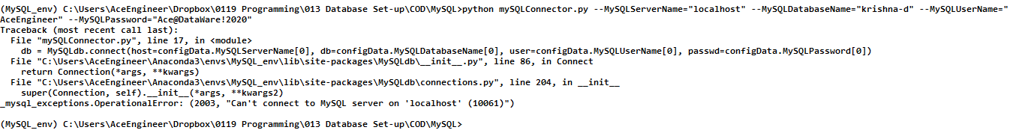
Test 3
python mySQLConnector.py --MySQLServerName="localhost" --MySQLDatabaseName="krishna-d" --MySQLUserName="AceEngineer" --MySQLPassword="Ace@DataWare!2020"
Unsuccessful connection | Result expected as there is no local server.

